Slide 1
DATA MODELS

Slide 2
DATA MODELS
A database model is a specification describing how a database is structured and used.
A database standardizes another.
model organizes data elements and how the data elements relate to one

Slide 3
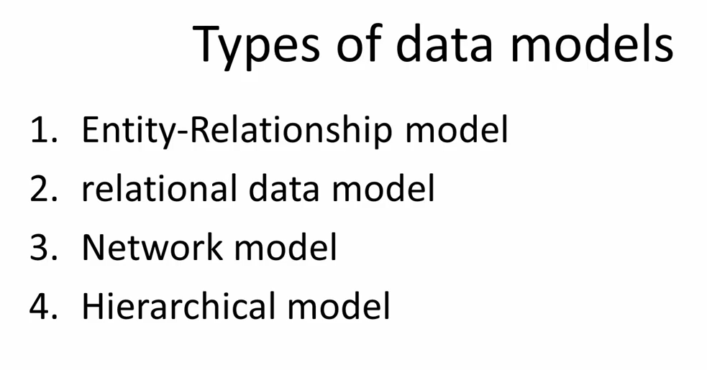

Slide 4
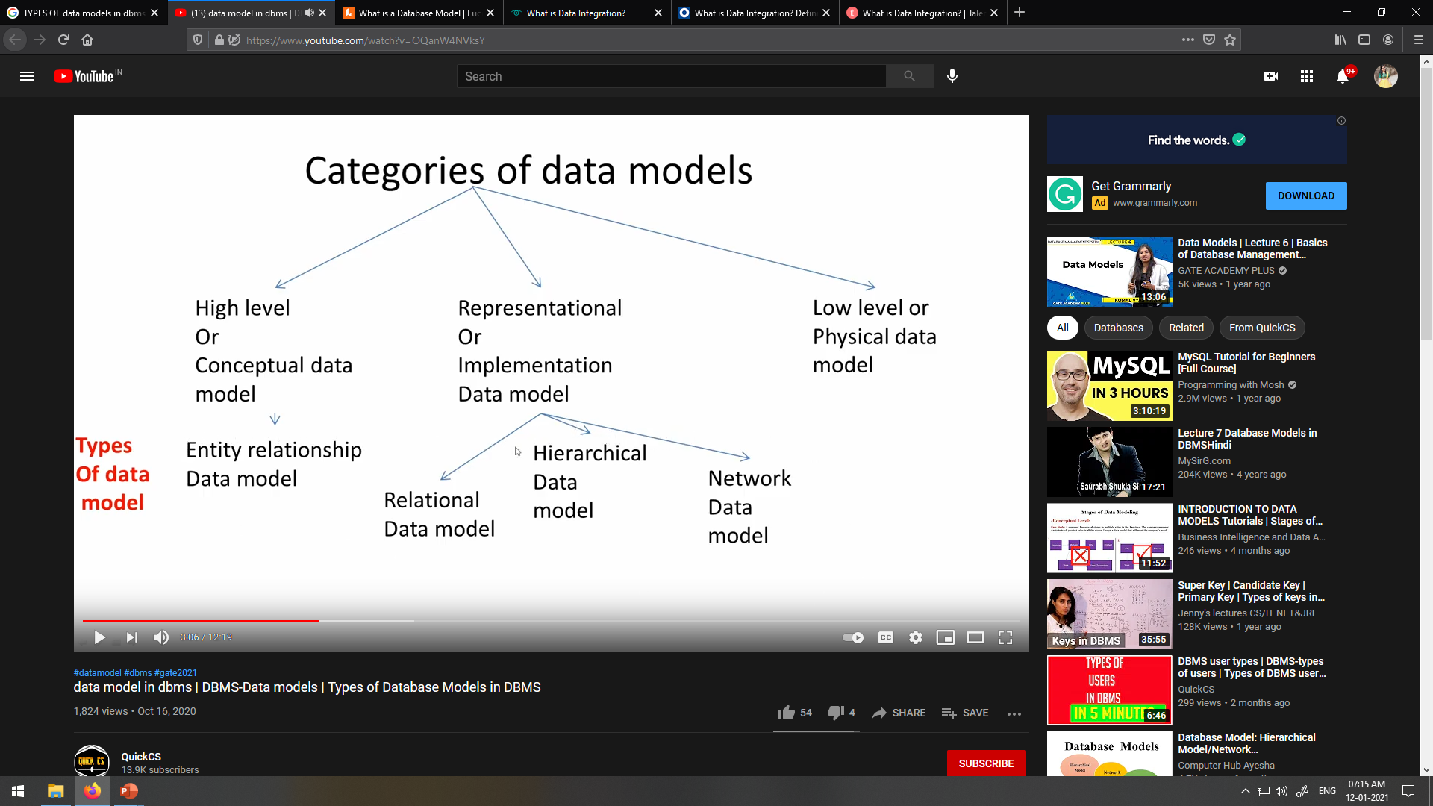

Slide 5
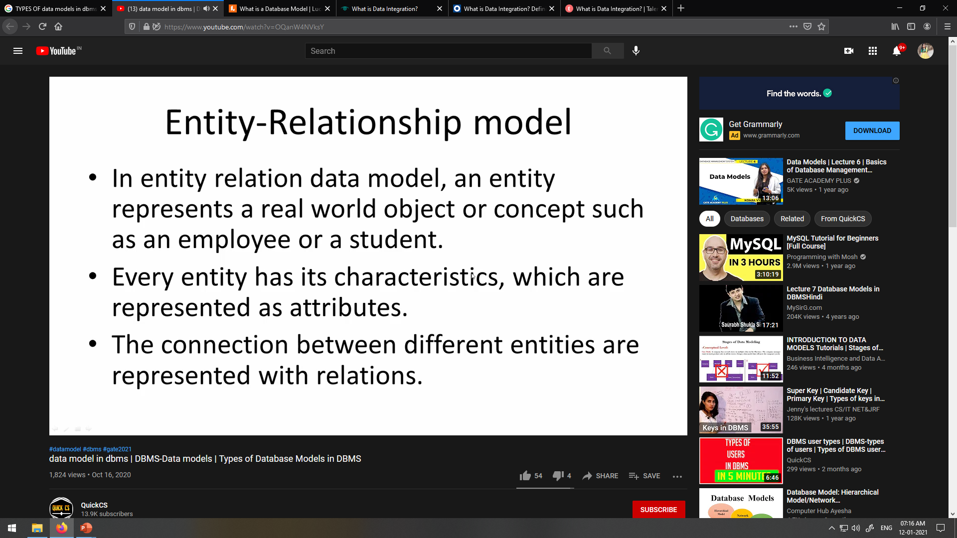

Slide 6
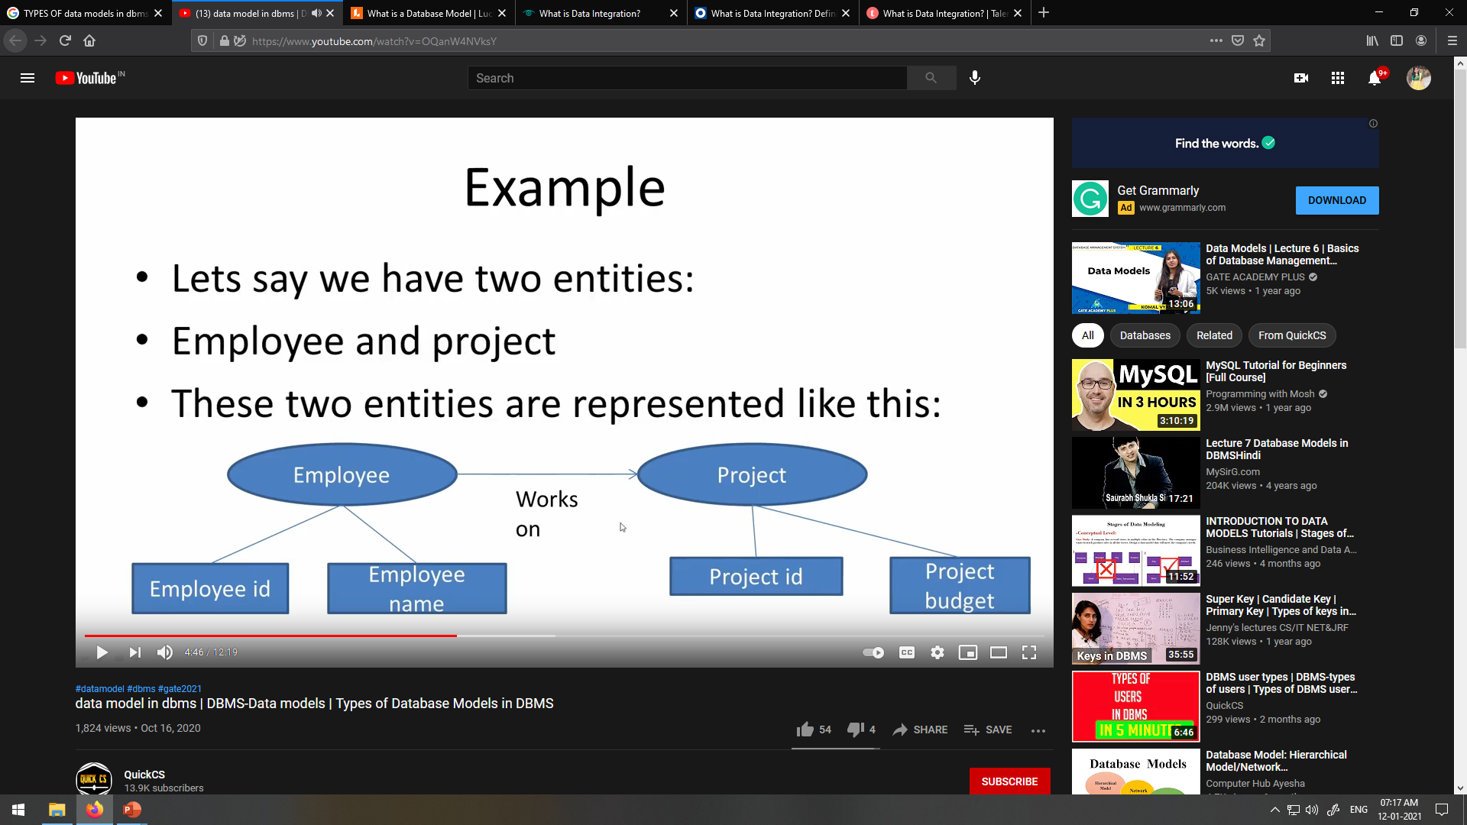

Slide 7
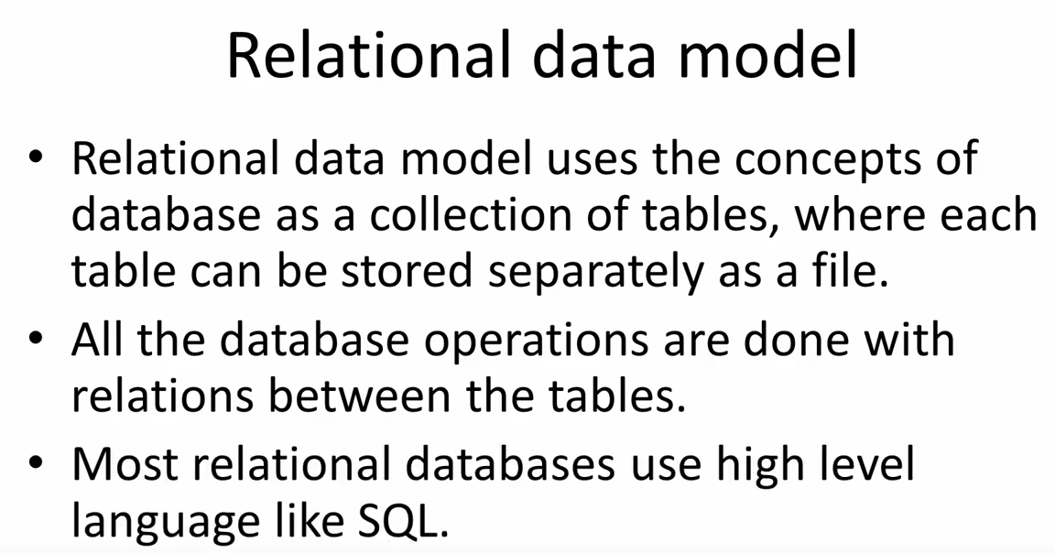

Slide 8
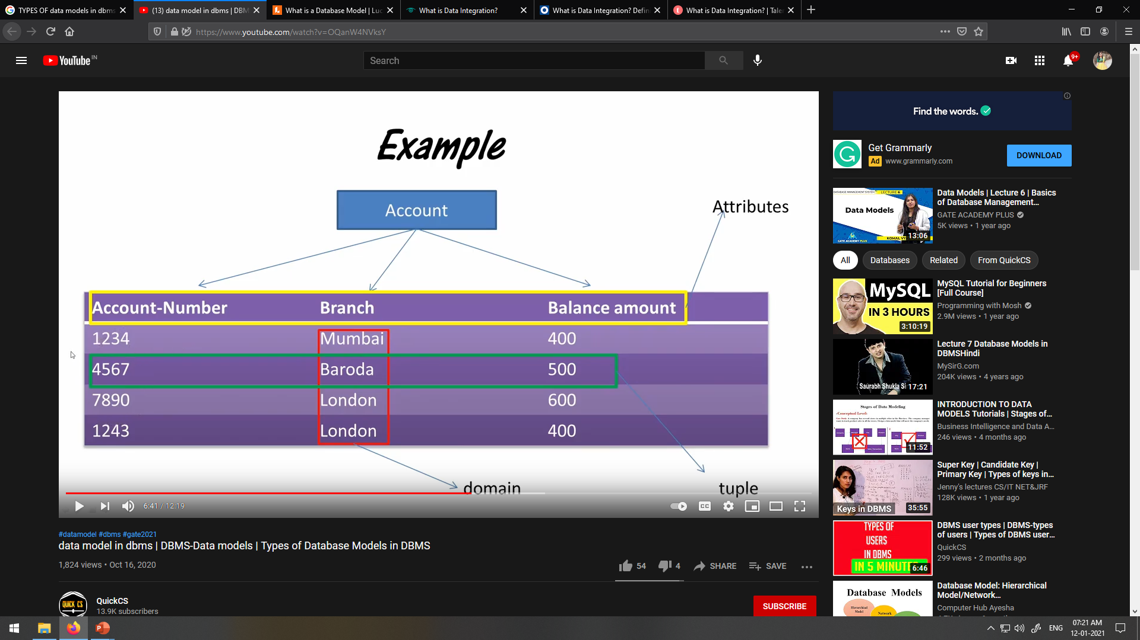

Slide 9
Database Concepts
DATA MODELS
RELATIONAL MODEL - CONCEPT
Tables: In relation data model, relations are saved in the format of Tables. This format stores the relation among entities. A table has rows and columns, where rows represent records and columns represents the attributes.
Tuple: A single row of a table, which contains a single record for that relation is called a tuple.
Attribute : columns are referred as attributes.
Domain: A pool of values from which the actual values appearing in a given column are drawn.

Slide 10
Database Concepts
DATA MODELS
RELATIONAL MODEL - CONCEPT
What does Primary Key mean?
A primary key is a special relational database table column (or combination of columns) designated to uniquely identify all table records.
A primary key’s main features are:
✓
✓
It must contain a unique value for each row of data. It cannot contain null values.
A primary key is either an existing table column or a column that is specifically generated by the database according to a defined sequence.

Slide 11
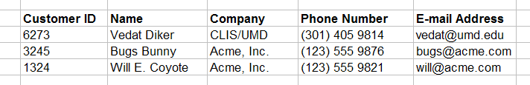
Database Concepts
DATA MODELS
RELATIONAL MODEL - CONCEPT
PRMARY KEY - TABLE - CUSTOMERS
primary key field
Primary key is a unique identifier of records in a table.
Primary key values may be generated manually or automatically.

Slide 12
Database Concepts
DATA MODELS
RELATIONAL MODEL - CONCEPT
What does Foreign Key mean?
A foreign key (REFERENTIAL INTEGRITY) is a column or group of columns in a relational database table that provides a link between data in two tables.
It acts as a cross-reference between tables because it references the primary key of another table, thereby establishing a link between them.

Slide 13
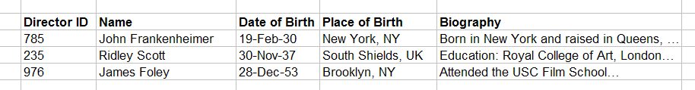
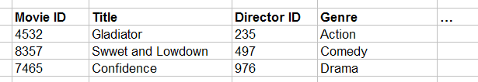
FOREIGN KEY
Primary key field
Parent table
Directors
Relationship
Movies
Child table
Foreign key field

Slide 14
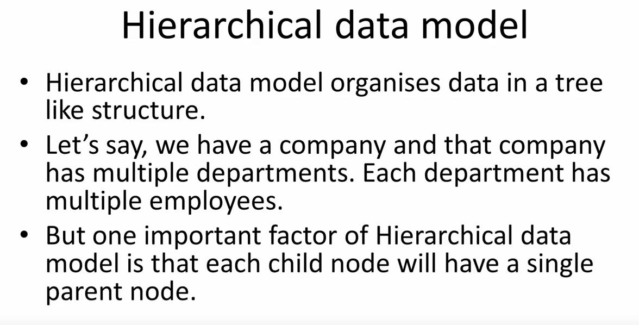
e.g. Census data organized by state, within state by city, within city by census.

Slide 15
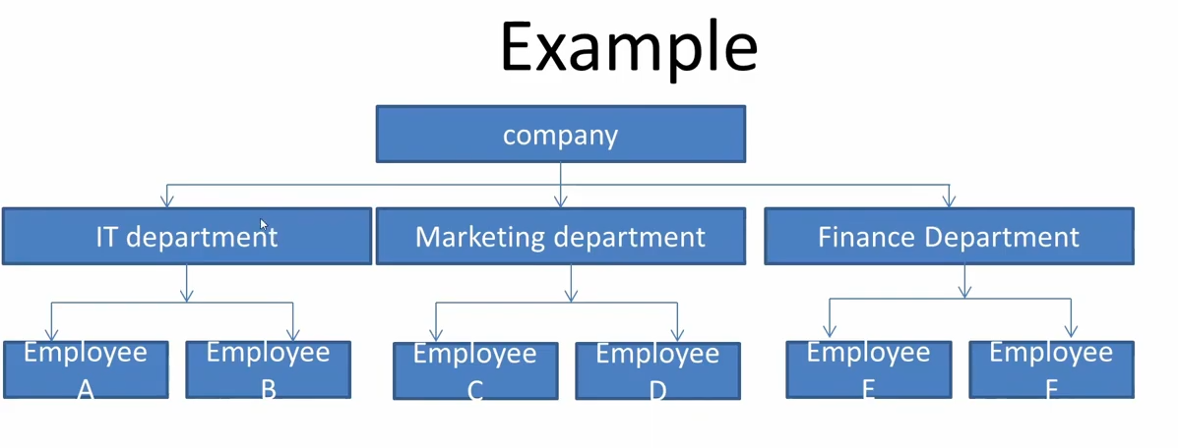

Slide 16
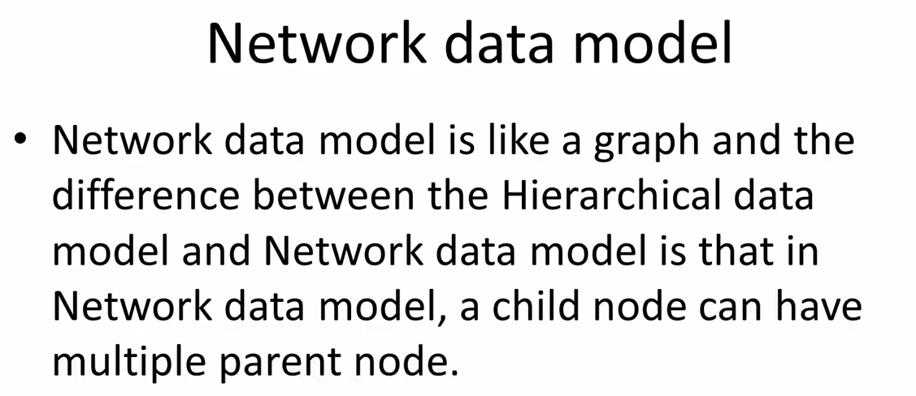

Slide 17
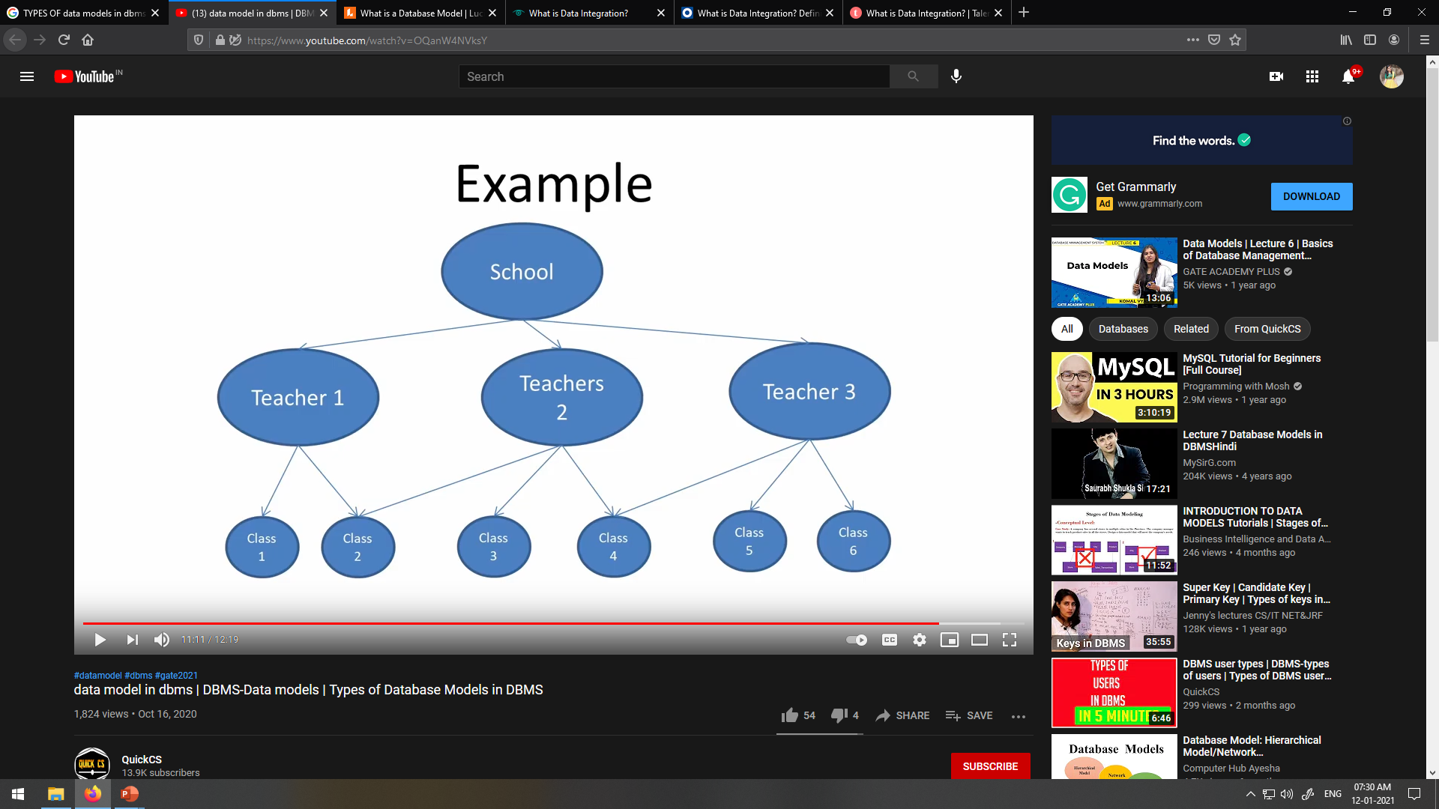

Slide 18
VIVA QUESTIONS
DIFFERENCE BETWEEN NETWORK AND HIERARCHICAL DATA MODEL.
WHAT IS PRIMARY AND FOREIGN KEY IN ENTITY RELATIONSHIP MODEL?

